Slide 1

AI Assistants Unlocking new levels of productivity across the enterprise IBM watsonx Orchestrate
Giulio Soliani
Product Lead, Digital Labor GTM
gsolian@ibm.com
Thomas Yang WW Technology Enablement thomas.yang@us.ibm.com Gerry Baird WW Technology Enablement gerry.baird@uk.ibm.com
Version 2.2 2024-02-02
Notes:
Welcome to the IBM watsonx Orchestrate client presentation. The objective of this presentation is to enable sellers how to present watsonx Orchestrate to prospective and existing clients.
This presentation assumes that both the seller and their target audience are familiar with watsonx, IBM’s AI and data platform, and how clients across many different industries are using it to augment their business performance and productivity to effectively compete in the marketplace.
Clients wishing to learn more about IBM watsonx Orchestrate can access the link below.
https://www.ibm.com/watsonx
Note to sellers:
Replace the current contact information with your name, title, and contact details on the title slide.
For the most recent client presentation, please reference the watsonX Orchestrate Sales Kit on Seismic: https://ibm.seismic.com/Link/Content/DCbHf2RCFTPf3G9Cc2PBGggJWfGV
AI Fundamentals Level 1 course: https://yourlearning.ibm.com/activity/PLAN-402D037C5668 (IBM) https://learn.ibm.com/course/view.php?id=13175 (Partner Plus)
Badge related to the course: https://www.credly.com/org/ibm/badge/watsonx-orchestrate-sales-foundation
Acronyms
ACE - App Connect Enterprise
API - Application Programming Interface
AI – Artificial Intelligence
Gen AI – generative AI
HR – Human Resources
IT – Information Technology
LLM – Large Language Model
OOTB – Out-of-the-box
Orchestrate – IBM watsonx Orchestrate™
OS - OpenScale
Req – Requisition
RPA – Robotic Process Automation
SaaS – Software as a Service
SDK - Software Development Kit
WO – IBM watsonx Orchestrate™

Slide 2
AI assistants for enterprise productivity
Notes:
As many people may already know or will learn through out this presentation, watsonx Orchestrate is IBM’s AI assistant platform designed to transform enterprise productivity. It does so by combining generative AI with best in class business automation capabilities and surfacing these through a highly conversational interface. This type of solution is top of mind for leaders across a variety of domains - ranging from the CIO (Chief Information Officer) to the CHRO (Chief Human Resources Officer) to the CPO (Chief Procurement Officer). They all have one thing in common - they are expected to drive productivity across their teams by leveraging generative AI and automation.

Slide 3

AI and automation are present across every moment of life
Completing a flight check-in
Updating a home address
Upgrading to a new TV plan
Requesting an auto insurance quote
Returning an order
Applying for a loan
Notes:
Over the last decade, technology has played an increasingly critical role in every moment and transaction in our lives. Enterprises have leaned into AI and automation based experiences across the daily life of consumers to stand out amongst ever-growing customer expectations. At the end of the day, customers are expecting experiences that match the technological innovations available on the market – they will pick the insurance provider that gives them near-instant access to a personalized auto insurance quote, they will choose the financial institution that makes it easy for them to be pre-approved for a loan, they will stick around for the business that lets them return orders with ease.

Slide 4

Advent of generative AI and the evolution of automation has ushered in an era of AI Assistants that are here to drive productive customer and employee experiences
Omni-present
AI Assistants
Personalized
Outcome-driven
Guided
Connected
Informational
Notes:
The advent of generative AI and the continued evolution of automation technologies have ushered in a new wave of what experiences will look like. The emergence of AI assistants (aka co-pilots) that sits alongside consumers and employees and fast-tracks them to that gratifying self-serve moment – the real outcome that businesses all seek to offer. These AI assistants need to work with the variety of back-end systems and processes required to automate experiences. Augmented by generative AI, these AI assistants offer a path to deliver personalized, contextualized, and business grounded informational help at every step of the way.
The path to adopt these AI assistants at scale has been paved from years of experience put into production AI and automation.

Slide 5
After years of investments in automation, employee productivity is still declining
Employees
average time an employee is productive
employees satisfied with their experience
~3 hrs
13%
Notes:
While brands have explored the use of AI Assistants to drive frictionless customer experiences, we believe there is an opportunity to maximize ROI on your AI and automation investments by tackling the next big challenge: driving employee productivity. Across enterprises worldwide, the need to boost productivity is growing quickly, it has become a key imperative to keep brands healthy and competitive in the market. Between the thousands of internal applications that need to be used, gigabytes of data, and knowledge required, it is becoming increasingly more difficult for employees to stay productive in the workplace.

Slide 6








Employee productivity is hindered by having siloed and disconnected tasks, systems, and processes
😭
Task is very manual and has not been automated yet…
navigating from one app to the other
manipulating data from one tool to the other
reconcile data
Employees are not experts in the process…
handling exceptions
chasing down approvals
Employees’ journey
Logistical delays…
struggle to learn the tool
hard to get tool to work as expected
runs into issues
chases experts
Non-job related tasks await…
don’t know what tool to use
don’t know the process
get stuck and spend a lot of time on it
Notes:
Picture an expert across any domain of an organization. Let’s pick the best HR Talent Recruiter in a company – their passion and focus is to discover, hire, onboard, and retain net new talent. The best recruiters need to spend their time reviewing candidates and building a strong relationship with qualified talent to accelerate them to that critical moment of getting them hired. Recruiters realize that behind each task there are a lot of manual steps as automations for that specific flow and their requirements are unique and don’t bubble up to the corporate priority list of standard repetitive tasks. This leaves the recruiter having to jump from application to application, stitching and manipulating data like important fields of a job requisition between those tools and then reconciling that data to ensure that the job posting is truly reflective.
On top of that, recruiters are faced with the challenge of using tools in which they are unfamiliar and spend too much of their time trying to understand processes in which they are not an expert. And when they're about to reach that conclusion, they realize they don't know how to handle exceptions and they need to seek further approvals, thus delaying their outcome one more time.
This same pattern applies to other experts across the enterprise. For example, for sellers looking to prospect and engage with customers and having to reconcile prospecting data with existing CRM (Customer Relationship Management) client data. It also applies to procurement specialists inundated with requests from both vendors and suppliers.

Slide 7














IT teams have developed task-specific productivity tools, but democratized automation for end-to-end process remains a gap
Employees
Company apps
company intranet
Notes:
The need for automation is growing faster than technology can be rolled out. Traditional automation solutions are focused on streamlining mission-critical business processes; however, employees still face productivity issues in their day-to-day work. Employee needs for accessible and intelligent automation are unmet because their requirements are unique and don’t typically bubble up to the corporate priority list of standard repetitive tasks

Slide 8
Friction points behind employee productivity
Employees stepping through expert level tasks
Employees stepping through tasks they are not experts in
Spend hours performing manual cumbersome tasks
Spend hours figuring out how to get something done
Have to use 13+ applications and systems
No idea where to get help with over 1000 applications
Struggle to stay up-to-date on relevant information
Don’t know what kind of information they need
Notes:
Looking closely at the friction points hindering employee productivity, it’s easy to see that employees are tasked with using multiple tools and systems in which they are sometimes unfamiliar with how to use, completing manual tasks and hunting for information, and trying to complete tasks that they are not experts in - wasting time just trying to figure out how to get something done.
On the left-hand side, there are experts performing expert level tasks and they need to spend hours performing manual stitching of data and flows. They need to learn to use typically 13+ applications and systems and try to remain expert and proficient with all of them. Often, they struggle to stay up to date on relevant information as it continuously evolves.
On the right-hand side, those same employees are very often not experts in other tasks that the enterprise requires of them. For example, they'll spend hours figuring out how to fulfill a simple HR or IT administrative task. They have no idea where they can get help because there's hundreds and hundreds and thousands of applications that could help them. However, it is difficult for them to keep up and they feel stuck because they don't even know what kind of information, they need to fulfill those kind of tasks.

Slide 9
watsonx orchestrate: Unlock productivity with AI assistants
Harness the power of generative AI and automation to free up individuals across the enterprise from tedious daily tasks
Employees stepping through expert level tasks
Employees stepping through tasks they are not experts in
Spend hours performing manual cumbersome tasks
Have to use 13+ applications & systems
Work, reimagined.
No idea where to get help with over 1000 applications
Struggle to stay up-to-date on relevant information
Don’t know what kind of information they need
Notes:
It is time to REIMAGINE WORK. With AI Assistants, enterprises can harness the power of AI and automation, and free up individuals from the drudgery of work: copy and pasting or editing data in applications, clicking from system to system, chasing after work and people. Individuals no longer need to build expert knowledge of how to run software applications, execute business processes, or adhere to enterprise policies. Rather, employees can stay focused on business development and innovation – the higher-level work that is important to the business.

Slide 10




















IBM’s strategy: AI Assistants for business
Customer Care
Sales
Supply Chain
Procurement
Finance
HR
Use cases
Digital self-serve
Modernize contact center
Case management
Agent Assist
Contact Center Insights
Use cases
Buyer experience
Lead management
Opportunity management
Seller support
Use cases
Sourcing Support
Supplier Management
Sustainability
Inventory Management
Use cases
Procure to pay
Contractor requisitions
PO management
Supplier assessment
Use cases
Source to Pay
Order to Cash
Expense Management
Auditing
Financial Reporting
Use cases
Talent Recruitment
Onboarding
Payroll
Compensation
Employee support
Business impact
Better resolution times
Reduced costs
Improved NPS/CSAT
Higher agent retention
Business impact
Higher conversion rate
Increased order size
Improved upselling
Customer retention
Business impact
Cost per order
Lead times
Order cycle time
Business impact
Improved onboarding
Reduced external spend
Improved sourcing
Business impact
Cost per transaction
Days sales outstanding
Time to close period
Business impact
Time to offer
Cost per hire
Reduced support cost
1-click resolution rates
CONVERSATIONAL | ORCHESTRATES SKILLS | CONTEXTUALIZED OMNI-CHANNEL | MULTI-CLOUD
AI Assistants for Digital Labor
CLASSIFY | GENERATE | SUMMARIZE | EXTRACT
SEMANTIC SEARCH | VECTOR DB
RPA | WORFKLOW | DECISION | DISCOVER EXISTING
Generative AI Skills
Knowledge Skills
Automation Skills
INTEGRATIONS
Notes:
IBM’s AI Assistants are designed to help customers, employees, and knowledge workers fulfill complex tasks. These are not meant to be co-pilots. These AI Assistants augment existing productivity tools, bring in critical knowledge, infuse Gen AI to fast track users through tasks to ensure highest levels of productivity and quality outcome.

Slide 11






IBM's AI assistants use Foundation Models and Automation to orchestrate skill execution and reduce time and effort
Customers, employees, and knowledge workers
AI Assistant
Skills
digital automations that wrapper integrations to applications, systems, workflows, or AI models
Guided skills
Informational skills
Conversational skills
Automated skills
more skill types
Notes:
Employees and customers can leverage AI Assistants like watsonx Orchestrate to automate complex processes involving the multiple tools they already use everyday. The AI Assistants leverage large language models to understand and guide the users through complex processes and orchestrate the existing and new automations to get things done.
Picture an HR Talent Recruiter – typically they’re jumping from Workday to Excel to Outlook to LinkedIn, stitching and manipulating data, switching screens, waiting for manager’s approvals. It’s a frustrating experience for employees and hampers enterprise productivity.
AI Assistants use foundation models to manage skill execution – skills being digital automations that wrapper integrations to applications, systems, workflows and AI models – and ultimately reduce the time and effort the employee spends accomplishing a single task.

Slide 12









watsonx Orchestrate: AI assistants for enterprise productivity
Engage via channels
Democratize the availability of automation through natural language across multiple channels
Conversational experiences
1
Invoke advanced skills
Customers
HR
Procurement
Sales
→ Create new PO
→ Pay supplier
→ Process invoices
→ Create job requisition
→ Schedule interview
→ Generate offer email
→ Identify upsell accounts
→ Recommend new plans
→ Generate client email
2
Invoke advanced skills that leverage generative AI to accomplish net new tasks
CLASSIFY | GENERATE | SUMMARIZE | EXTRACT
Employees
Generative AI skills
Execute automations
3
Power AI assistant skills leveraging existing automation
SMEs
Notes:
IBM watsonx Orchestrate is the platform through which IBM delivers AI assistants for enterprise productivity.
Orchestrate has a highly conversational front-end experience for customers, employees, and experts. Through that conversational experience, Orchestrate is able to invoke advanced skills of various types, including generative AI and automation skills. Automation skills will execute automations, allowing the expert or employee to fast track through the outcome they set out to achieve.
Using Orchestrate, enterprises are now able to democratize the availability of those automations through a simple natural language interface, which all users can easily access. Generative AI comes in handy as it powers the conversational experience, and it can also power different levels of self-service
Acronyms:
SME – Subject matter expert

Slide 13













Included in entitlements
One platform to build Gen AI + Automation assistants
Facilitated integration
Self-training
Auto improve flows based on user interactions
AI Assistant builder
Design and build custom AI Assistants that guide users through complex Actions they are trying to take. Custom Assistants leverage LLMs to dynamically invoke Skills from the Catalog and from existing automations.
IBM Robotic Process Automation
IBM Business Automation
Skills catalog
Invoke 1000s of pre-built skills for HR, Finance, Procurement, and sales. CP4BA SaaS or On-Premise Capabilities are discovered when connected.
Workflow
Content Services
Builders
Automation builder
Create and manage low-code automations that combine automated decisions, tasks, GenAI services, and workflows in a single authoring experience to power AI assistants
Decision Management
Process Mining
Operational Intelligence
Enterprise readiness
Built-in lifecycle and catalog management, analytics, access and federated controls, security and compliance.
3rd Party Systems
Notes:
IBM watsonx Orchestrate offers a unified platform for builders to launch and manage AI assistants at scale.It includes an assistant assembler to design and build sophisticated AI assistants that can actually guide users through complex actions. Orchestrate contains a comprehensive skills catalog with thousands of prebuilt skills across HR, finance, procurement, and sales. Orchestrate can also connect to IBM automation systems as well as third party vendor automation systems. If those automations don't exist, builders have access to a low-code, simplified offering automation builder. Builders can then build automations and trigger them as skills directly from Orchestrate. Orchestrate has enterprise readiness components that includes catalog management, analytics and access and federated controls to ensure that the implementation remains aligned to the security and compliance controls of an enterprise.
Acronyms:
CP4BA – Cloud Pak for Business Automation
SaaS – Software as a Service

Slide 14
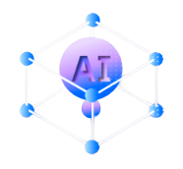
IBM watsonx Orchestrate patterns of use across the enterprise
Re-Imagine Domain Insights
Knowledge becomes accessible for all
Accelerate Growth
Accelerate innovation by embedding AI Assistants into workforce and operations plans and organizational structures
Deeper insights into the market and internal data you work with day-to-day
Structured transparency of your data with language prompts
Enhance Experience
Engage with internal teams quickly with low effort to focus on relationship building and high value tasks.
Digitalize Functional Process Tasks
Unleash new Business Value
Survey complex, diverse sources of data, detect, analyse, communicate and act upon insights seamlessly, in real-time
Increasing Productivity for your professionals
Streamlined task management of critical processes
Build automations for how your functional teams work day-to-day
Improve Agility
Adopt flexible operating models to respond quickly to vendors and existing customers

Slide 15

watsonx Orchestrate, with insights, works with your financial processes
AskFinance
Transforming your pain points…
Manual Data Entry
Disparate Systems and Data Silos
Complex Regulatory/Compliance Requirements
Inefficient Planning and Forecasting Processes
Lack of Real-Time Visibility and Analytics
Source to Pay
Order to Cash
…into benefits
Increased Efficiency and Productivity
Enhanced Data Accuracy and Integrity
Improved Compliance and Risk Management
Real-Time Financial Insights and Analytics
Scalability and Cost-Savings
Expense Management

Slide 16
watsonx Orchestrate, with insights, works with your procurement processes
AskProcurement
Transforming your pain points…
Maverick Spending and Lack of Spend Visibility
Manual and Inefficient Sourcing
Supplier Risk and Performance Management
Limited Category Management
Disconnected Systems and Data Issues
Contract Management
Procure to Pay
…into benefits
Improved Spend Management and Cost Savings
Streamlined Sourcing
Enhanced Supplier Risk Management
Optimized Category Strategies
End-to-End Process Visibility and Analytics
Purchase Order Management

Slide 17
watsonx Orchestrate, with insights, works with your sales processes
AskSales
Transforming your pain points…
Inefficient Lead Management and Follow-Ups
Disconnected Customer Data and Systems
Manual Forecasting and Pipeline Management
Ineffective Content and Enablement Management
Limited Insights into Customer Preferences
Opportunity management
Buyer experience
…into benefits
Streamlined Lead Nurturing and Conversion
Unified Customer Data and 360-View
Accurate Forecasting and Pipeline Oversight
Personalized Sales Content Delivery
Data Driven Insights for Targeted Sales Strategy
Lead management

Slide 18
watsonx Orchestrate, with insights, works with your supplier processes
AskSupplyChain
Transforming your pain points…
Lack of End-to-End Supply Chain Visibility
Inefficient Inventory Management
Manual Order Management Processes
Disruptions in Global Supply Chain
Limited Sustainability and Footprint Tracking
Sourcing Support
Supplier Management
…into benefits
Real-time Supply Chain Insights
Optimized Inventory Levels
Automated Order Processing and Fulfillment
Improved Resilience and Risk Mitigation
Enhanced Sustainability Tracking
Sustainability/ Compliance

Slide 19
AI assistants are more than a bot or co-pilot
Intelligent interactions
Expanding expertise
Accelerate time to value
Conversational
Let Gen AI handle complex conversations and fulfill tasks for the user
Dynamic Sequencing
Manages skill execution in sequence for users to multi-task
Automation Builder
Simplified builder experience to create new workflow and decision-based skills
Context aware
Delivers contextualized experiences every step of the way
Skills
Orchestrates 1000s of prebuilt skills. Easily discover and train new skills from existing automations
Assistant Builder
Design flows for complex and nuanced journeys with a no-code and LLM powered interface
Hand-holds users
Uses Gen AI to guide users through new to tasks and adhere to processes
Generative AI
Surfaces generative AI skills to augment user tasks, backed by the governance enterprises need
Skill training
Use generative AI to accelerate training and enhance skills
Notes:
IBM watsonx Orchestrate deliver AI assistants that go beyond what traditional bots or copilots can do. AI assistants are focused on end-to-end enterprise productivity, not just a simple augmentation of a productivity tool. Orchestrate is a platform that allows enterprise to drive intelligent interactions for consumers, internal employees, and internal experts all through one single platform. It allows enterprises to expand expertise and drive productivity for all those personas. The platform itself is designed to accelerate time to value for those same enterprises.
When it comes to intelligent interactions, generative AI is the main player. Orchestrate uses a transformer-based model so that it can truly understand what users are looking for. Orchestrate can clarify and topic switch and use those techniques to make sure the conversation feels seamless. Orchestrate can understand and hold context so that it can be aware of what the user is really looking to do and it can use that context to generate personalized experiences.
Orchestrate can even guide users to complete tasks so that enterprises not necessarily duplicating automations or providing complex information responses when the digital self-serve capability already exists and we just want to guide and teach users through how to go through it.
The main and core way by which users are going to be productive is that they're able to expand their expertise and unlock thousands of prebuilt and custom skills. Those custom skills are surfaced with generative AI so that they can advance user tasks. Tasks can be run in parallel allowing users to multitask as they go through their day-to-day job.
The Orchestrate platform includes builder modules to accelerate and fast track users to standing these AI assistants up and having them go live across the enterprise. It allows teams to design flows for complex and nuanced journeys with an assistant builder. Orchestrate allows to build automations within a simplified low-code experience and we use generative AI to accelerate training and enhance those skills in order to make them production ready.

Slide 20
IBM leads the market in business automation with AI
IDC
IBM ranking: #1
Worldwide Artificial Intelligence Services
Market Analysis Perspective: Worldwide Analytics and Intelligent Automation Services, 2021
IBM ranking: Major Player
Cloud Content Services
IDC MarketScape Worldwide Cloud Content Services 2022 Vendor Assessment
IBM ranking: Major Player
Robotic Process Automation
IDC MarketScape Worldwide Robotic Process Automation Software Vendor Assessment, 2021–2022
Nelson Hall
IBM ranking: Leader
Process Discovery & Mining
Vendor Evaluation & Assessment Tool, 2021
Forrester
IBM ranking: Leader
Digital Process Automation Software
The Forrester Wave: Digital Process Automation Software, Q4 2021
IBM ranking: Leader
Decision Services
The Forrester Wave: Digital Decisioning Platforms, Q4 2020
IBM ranking: Leader
Robotic Process Automation
The Forrester Wave: Robotic Process Automation Services, Q2 2022
IBM ranking: Strong Performer
Content Services
The Forrester Wave: Content Platforms, Q2 2021
Omdia
IBM ranking: Leader
Content Services
Omdia Universe: Selecting a Content Services Platform, 2021
Gartner
IBM ranking: Leader
Conversational AI Platform for Enterprises
Garter Magic Quadrant 2023
IBM ranking: Leader
Conversational AI Platform for Enterprises
Garter Magic Quadrant 2022
IBM ranking: Leader
Insight Engines
Garter Magic Quadrant 2022
Everest Group
IBM ranking: Major Contender
Robotic Process Automation
PEAK Matrix® Assessment 2022
IBM ranking: Major Contender
Process Mining
PEAK Matrix® Assessment 2022
IBM ranking: Major Contender
Intelligent Document Processing
PEAK Matrix® Assessment 2022
Notes:
IBM leads the market in business automation with AI as seen in top rankings by IDC, Forrester, Gartner, and so on. IBM has leveraged decades of experience in business automation and AI, bringing them together to deliver this next generation of AI assistants.

Slide 21





How users access generative AI capabilities in watsonx Orchestrate
watsonx.ai delivers IBM developed fine-tuned models out of the box in watsonx Orchestrate
Trustworthy
Contextual
users of watsonx.ai can serve OS or custom models to watsonx Orchestrate
Employees
Efficient
3rd party provider
users of 3rd party LLMs can serve their models to watsonx Orchestrate
other LLMs
Notes:
Users can access generative AI capabilities in watsonx Orchestrate through watsonx.ai or 3rd party LLMs (Large Language Models). IBM watsonx.ai delivers IBM developed fine-tuned models prebuilt in watsonx Orchestrate. Users of watsonx.ai can also serve OpenScale (OS) or custom models to Orchestrate. And users of 3rd party LLMs can serve their models to Orchestrate (via OpenAI endpoint), making it easy to customize Orchestrate to unique employee needs.

Slide 22

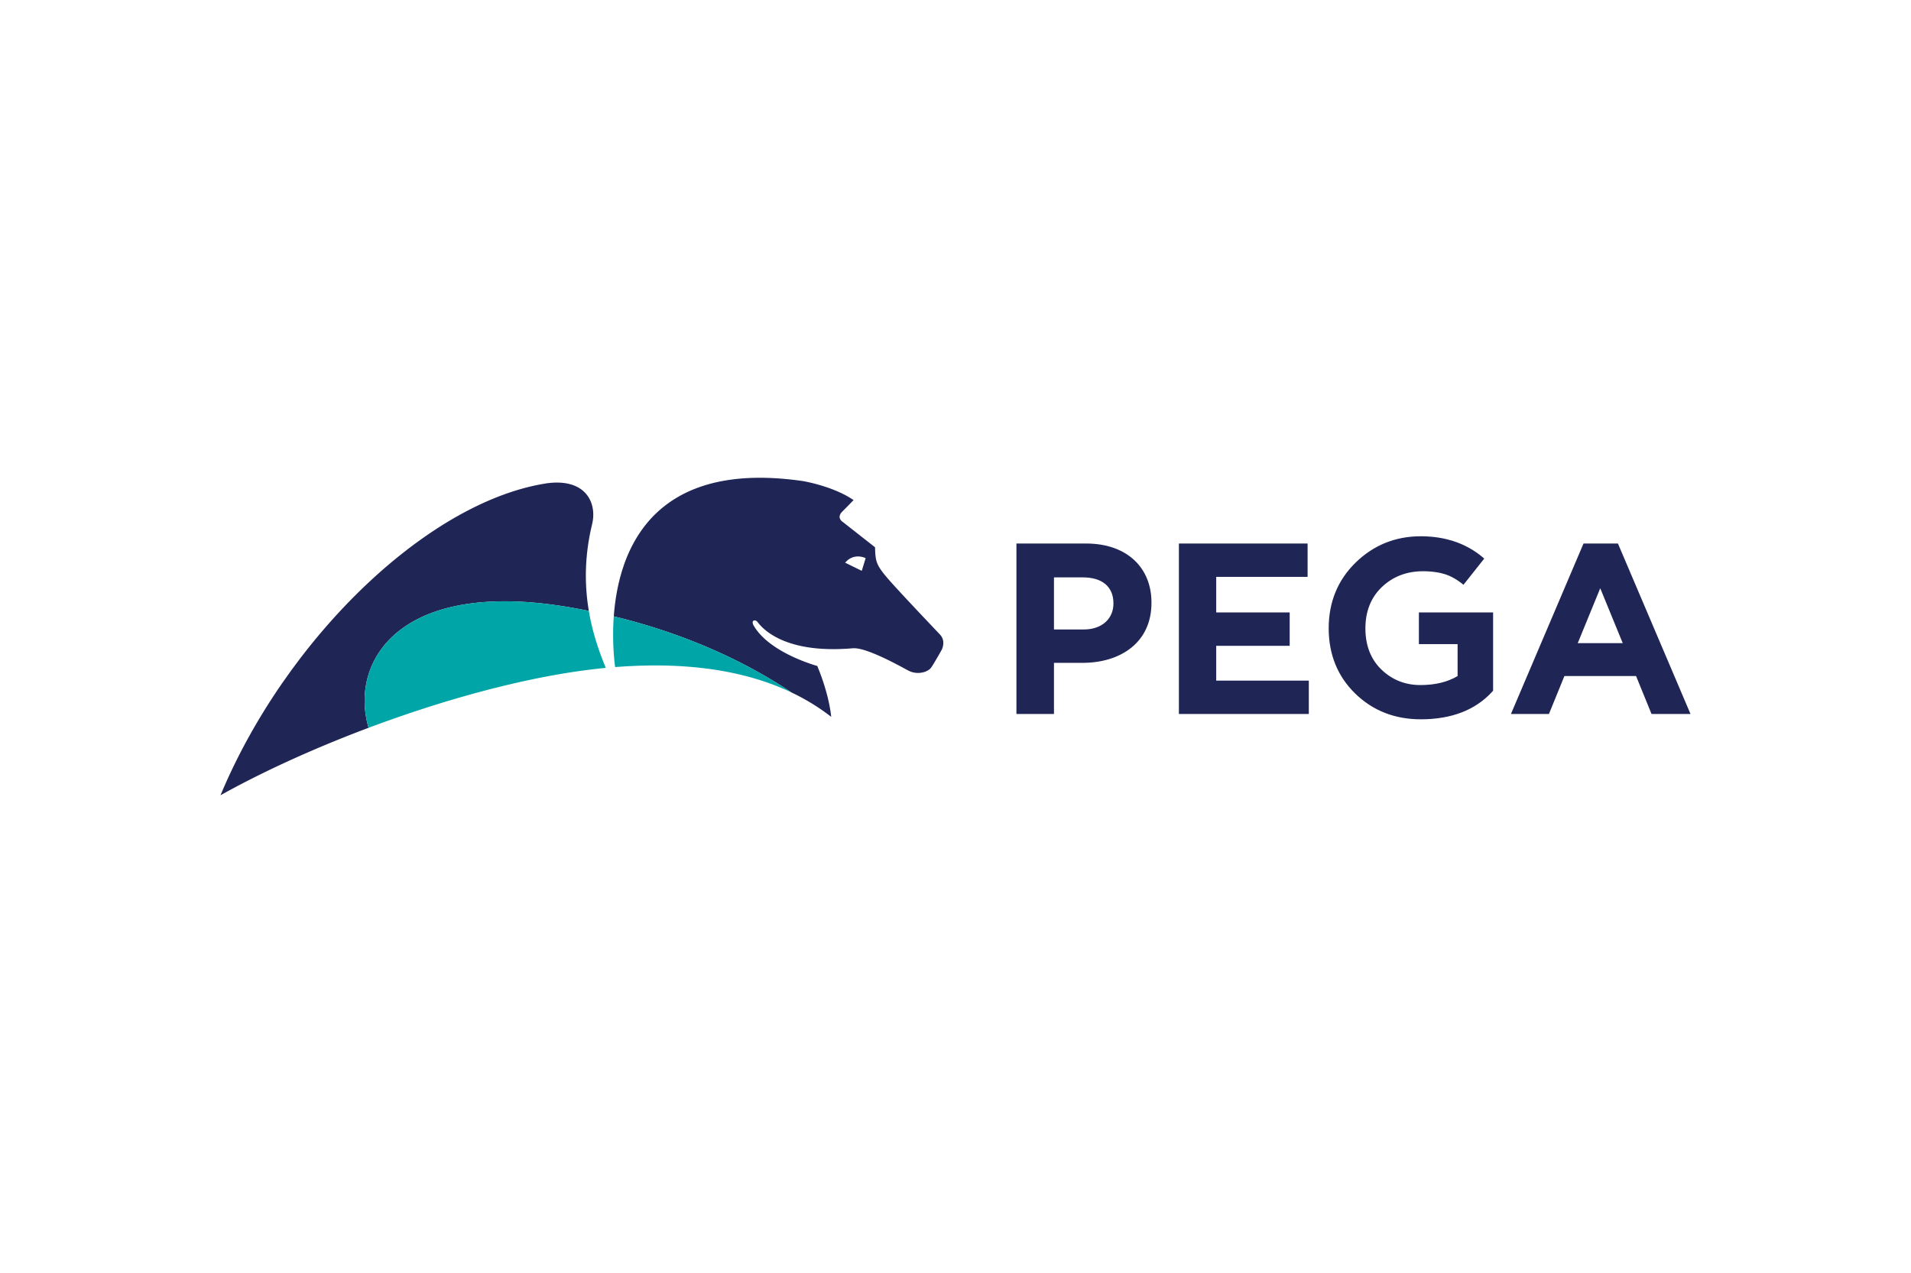
Skills – a core capability of watsonx Orchestrate
Skills originate from 3 sources
Prebuilt Skills aligned to entry point use cases
1000s of prebuilt skills aligned to customer care, human resources, sales, and procurement domains without specialized training
Discover and train automations across the enterprise
Teams can uncover new automations by using robotic process automation (RPA) and APIs to train Orchestrate on specific skills. CP4BA SaaS or on-premises capabilities are discovered when connected
Build custom automation with Automation Builder
Create and manage low-code automations that combine decisions, tasks, skills, and workflows in a single authoring experience to power AI assistants
Customers
Employees
SMEs
1
Conversational experience
Skills catalog
Skills are made up of integrations and/or automations and are sequenced together
watsonx Orchestrate delivers prebuilt skills, automation discovery and automation building tools for new skills
2
1
2
3
3
Out of the box
HR talent acquisition
Customer support
Procurement
Sales
Discover
Build custom
Workflows
Decisions
Document processing
Systems integration
RPA
Notes:
Skills are a core capability of IBM watsonx Orchestrate. IBM continues to invest in building thousands of prebuilt skills to align them to key entry point use cases. Orchestrate allows the ability to discover and train automations that already exist because they've been built after years and years of investments.
When automations don't exist, users can build them and they can build their own automations in the simplified automation builder low-code interface. By doing so, enterprises can bring thousands of personalized skills within each Orchestrate AI assistant and fast track users to the outcome they're looking for.
Skills originate from three sources:
Users can access a catalog with thousands of prebuilt skills aligned to domains and use cases that are repeatable and therefore no specialized training is needed to unlock those skills.
The second source is that with the new Automation Builder released in December 2023, users can discover and train automations from existing automation systems such as IBM RPA or third-party vendors.
And the third source is users can now build their own within IBM’s newly released Automation Service Builder. Automation Service Builder is a low-code authoring experience that allows teams to combine decisions, tasks and workflows and codify them as skills that can then be triggered by users.

Slide 23





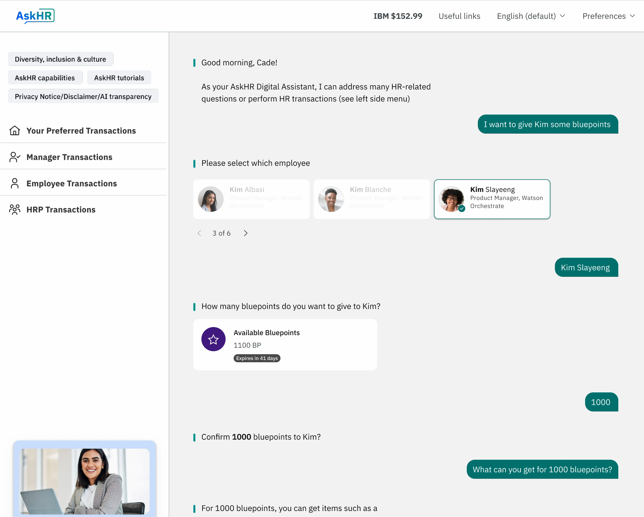
Assistant builder allows teams to fulfill complex journeys
Guide users to self serve when navigation is complex
Gen AI to hand-hold users
State of the art natural language understanding to resolve ambiguous conversations as users struggle to navigate through complex digital experiences
Show, tell, and do for outcome-driven experiences
Design a variety of self-serve experiences with no-code tooling: guide users through existing digital journeys, offer informational help, or transact on their behalf.
Extend to existing catalog Skills and Automations
Use the no-code Skill builder experience to design flows that align to existing business process automation. Leverage LLMs at runtime to dynamically guide the end-user through the process
1
2
3
Notes:
The assistant builder in watsonx Orchestrate allows teams to accomplish complex journeys by guiding users to self serve when navigation is complex. When users are working through complex digital experiences, they can leverage state of the art natural language understanding to help resolve ambiguous conversations. The assistant builder enables you to design a variety of self serve experiences with no-code tooling, guiding users through existing digital journeys, offering up information, and completing transactions on their behalf. And the no-code extension framework enables you to call back end systems or leverage existing automations – making the most of what you already have.

Slide 24
IBM as client zero: Transforming internally with the power of AI and Automation
1
Facilitating new generative AI business use cases
2
Scaling and accelerating existing use cases
Reinventing client support
25-point increase in NPS
26% cycle time reduction for classification and routing
Reinventing HR support
94% of cases solved by virtual assistant
837K automated transactions
Generative AI could create a 15-40% increase in productivity.
In one example, an IBM Data Scientist was able to accomplish what usually took two weeks in just one day.
Customer support
Talent transformation
External customer support
Summarization of cases to automatically create knowledge articles for use in case handoffs
Additional self-serve topics for clients with improved conversational capabilities via chatbots, with less effort in training
Improved quality of search results
Internal operations
Enable internal users to find solutions and get answers through an easy, compelling conversational UX
Promotion management
Simplify, standardize, and automate HR promotions processing
Staff augmentation automation
Automate identify-select-onboard end-to-end workflow with speed and quality
Notes:
IBM’s own experience in digitizing HR functions allowed IBM to bring AI and automation closer together. Orchestrate helped IBM understand the type of conversational and generative AI that is needed to work at scale, and the value that automation brings to expert knowledge workers to automate the daily functions of their lives. The HR team at IBM (a company that has over 200,000 employees across 177 countries) has successfully deployed watsonx Orchestrate across their enterprise, saving thousands of hours for workers each year.
All of these capabilities are currently being used within IBM transforming productivity with the power of generative AI and automation. From AskHR to AskIT to AskIBM, IBM watsonx Orchestrate is used in the daily lives of IBMers to drive productivity, whether it's supporting clients or internal talent transformation processes.
Digitizing supply chain
98% on-time client deliveries during market disruption
200K+ lbs. reduction in non-essential plastics
Modernizing lead to cash
252K seller hours saved with pricing analytics
97% reduction in billing and invoicing cycle time
External customer support
Summarization of cases to automatically create knowledge articles and for use in case handoffs
Additional self-serve topics for clients with improved conversational capabilities via chatbots, with less effort in training
Improved quality of search results
Internal operations
Enable internal users to find solutions and get answers through an easy, compelling conversational UX (User Experience)
Promotion management
Simplify, standardize, and automate HR promotions processing
Staff augmentation automation
Automate identify-select-onboard end-to-end workflow with speed and quality

Slide 25




Employee productivity augmented by watsonx Orchestrate
Using IBM watsonx Orchestrate to improve employee and customer happiness
25%
reduction in the time it takes to onboard new customers
Using AI to expand staff and drive employee engagement
30% Sport Clips is aiming to grow staff by 30% with the help of responsible AI and intelligent automation
Supporting job candidate satisfaction with intelligent automation
10-20% FloCareer aims to grow its staff by 10–20% with the help of responsible AI and intelligent automation
IBM® HR empowers human staff to devote more time to high-value tasks
12,000 hrs In a pilot for IBM Consulting in North America, IBM saved 12,000 hours in one quarter
Read the case study
Read the case study
Read the case study
Read the case study
Notes:
Clients are already delivering new productive experiences to their employees and customers with watsonx Orchestrate.
Avid Solutions uses Orchestrate to improve employee and customer happiness and has seen a 25% reduction in the time it takes to onboard new customers.
Case Study: https://www.ibm.com/case-studies/avid-solutions-international
Sport Clips is using AI to expand staff and drive employee engagement and is aiming to grow their staff by 30% with the help of responsible AI and intelligent automation delivered through watsonx Orchestrate.
Case Study: https://www.ibm.com/case-studies/sport-clips
FloCareer is supporting job candidate satisfaction with intelligent automation and aims to grow their staff by 10-20%.
Case Study: https://www.ibm.com/case-studies/flocareer
And lastly, IBM HR empowers human staff to devote more of their time to high value work by saving them 12,000 hours in manual tasks in 1 quarter.
Case Study: https://www.ibm.com/case-studies/ibm-human-resources-watsonx-orchestrate

Slide 26
Getting started with watsonx Orchestrate
Notes:
Getting started with watsonx Orchestrate

Slide 27
Three ways to get started today—IBM’s investment in partnering with clients
Interactive tour
Experience IBM AI Assistants with a tour of watsonx Orchestrate
Product Tour
Schedule a demo
Talk with IBM experts to understand how the solutions can be applied to selected use cases.
1 hour
Strategy session
Discussion and custom demonstration of IBM’s AI point-of-view and capabilities. Understand where generative AI can be leveraged now for impact in the business.
2-4 hours
Notes:
Every enterprise across every industry is pursuing productivity. In the same way IBM helps enterprises, IBM is driving extreme productivity by living in IBM hybrid cloud and AI strategy and digitally transforming IBM as Client Zero.
Eliminating operational complexity, simplifying end-to-end workflows, automating manual tasks, and deploying AI across all operations is unleashing the productivity of IBM’s people and fueling investments in IBM’s growth.
Enterprises look to IBM to help deliver innovative and meaningful solutions with speed and efficiency. There is no better place to test IBM solutions than internally, with the leading offerings and capabilities from IBM Technology, IBM Research, and strategic partners; and the business transformation expertise from IBM Consulting.
The best way to understand what AI assistants can do for an organization is to try them directly. To get started, IBM offers a variety of ways by which enterprises can access and unlock productivity. Clients can take interactive tours to learn more about IBM AI assistant platform – IBM watsonx Orchestrate. Clients can schedule deep-dives with IBM experts, or they can engage with a set of IBM experts and define their use cases through a best in class strategy session.
Product Tour:
https://www.ibm.com/account/reg/us-en/signup?formid=urx-52411

Slide 28
Notes:
This slide is self explanatory and requires no speaker notes.

Slide 29
AI assistant solutions by industry

Slide 30
AI assistants in Customer care
Serving customers is priority number one for enterprises and is among the most frequent and costly touchpoints to maintain. Imagine a new world where service quality improves while driving down costs, empowering customers with technology to resolve their problems through automation and AI.
Digital customer experience Communicates with customers 24/7 across all digital touch points in a conversational interface using natural language.
Modernize contact center Automate resolution of customer issues across all support channels decreasing call volume.
Agent assist Conversational and generative AI assists customer service representatives to resolve advanced customer queries reducing call time.
Notes:
Within customer care we see an opportunity for conversational and generative AI to transform the way your consumers self serve.

Slide 31
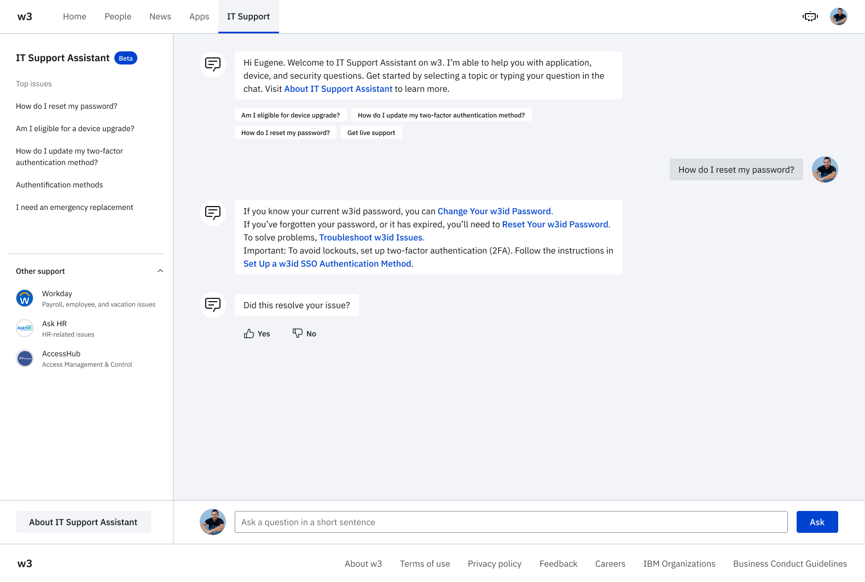
AI assistants in IT
Safe to say that no one looks forward to dealing with the IT helpdesk. This perhaps more than any other high-frequency enterprise task can reap the benefits of the entire AI and automation tool kit in a large percentage of E2E use cases, leading to faster resolution times with little or no human involvement.
IT self-serve Resolves IT support topics for employees 24/7 in a conversational interface using natural language.

Slide 32
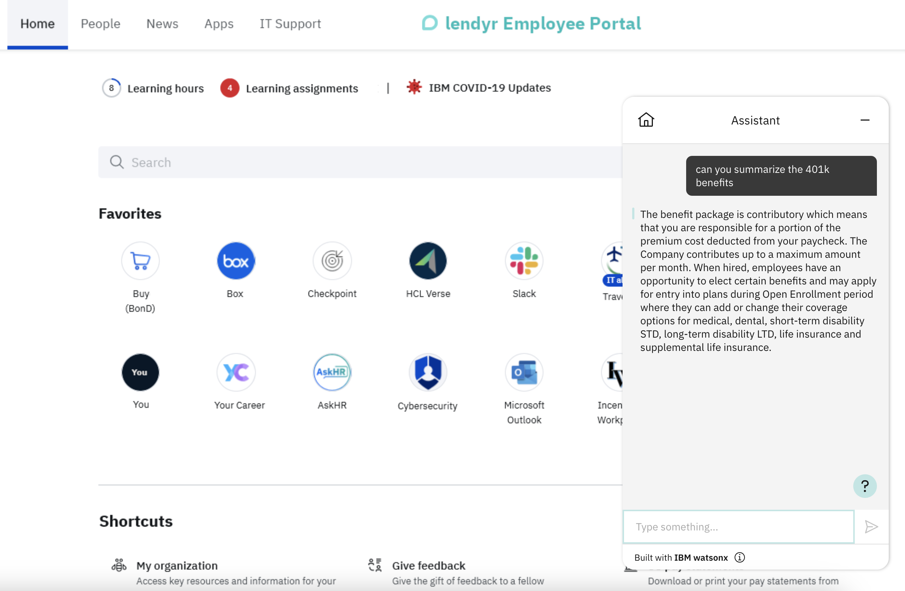
AI assistants in HR
Empowering employees to spend less time getting the information they need to manage critical aspects of their job, as well as automating resolution processes is a boon for productivity. It can add up to days per month saved and turn this into a truly background task.
Employee self-serve Resolves HR topics (travel, compensation, etc.) for employees 24/7 in a conversational interface using natural language.
Talent recruitment Streamline all HR tasks from talent recruitment to payroll and compensation by letting HR experts self serve via natural language.
© 2023 IBM Corporation
32

Slide 33
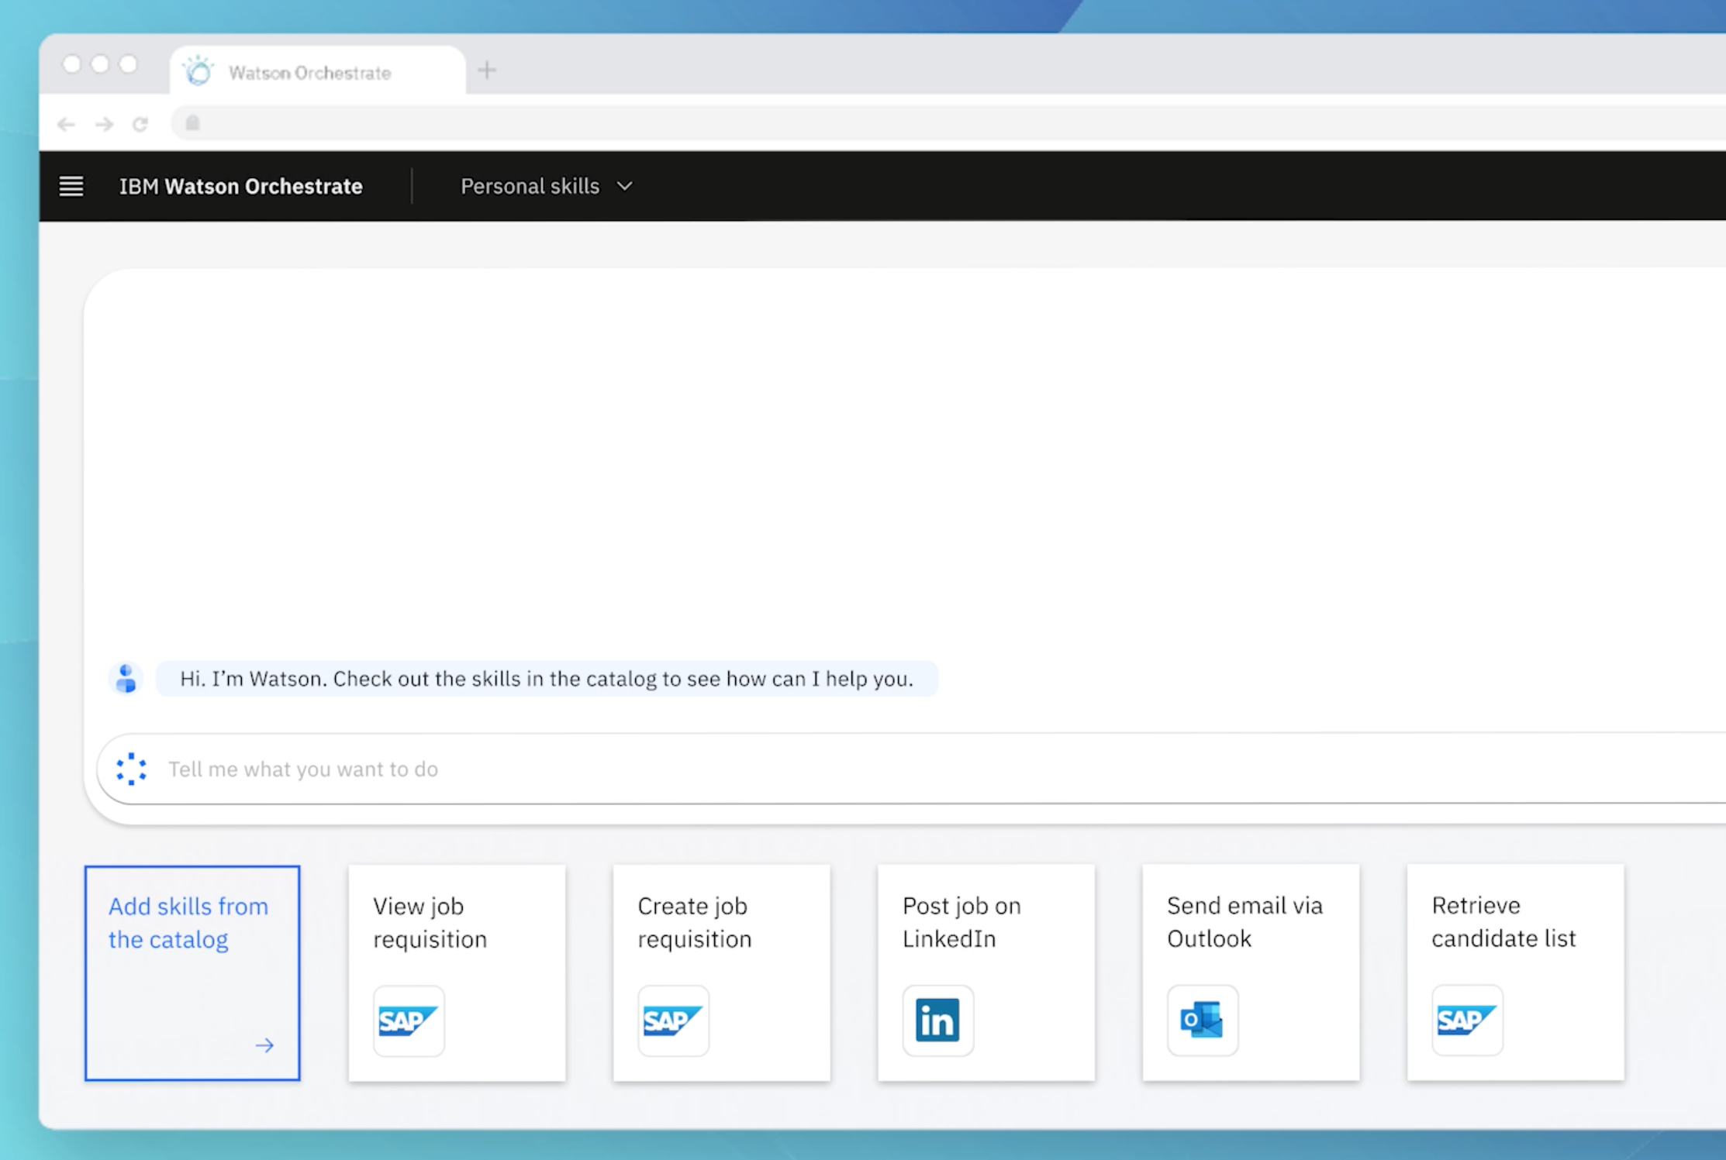
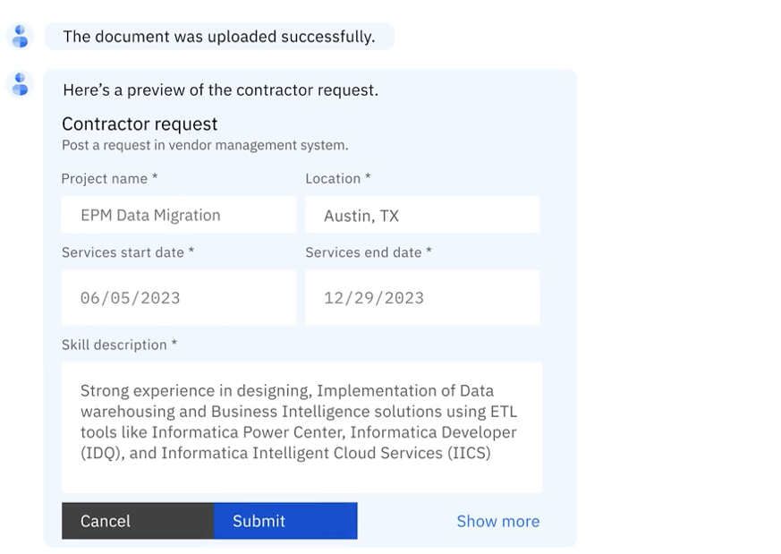
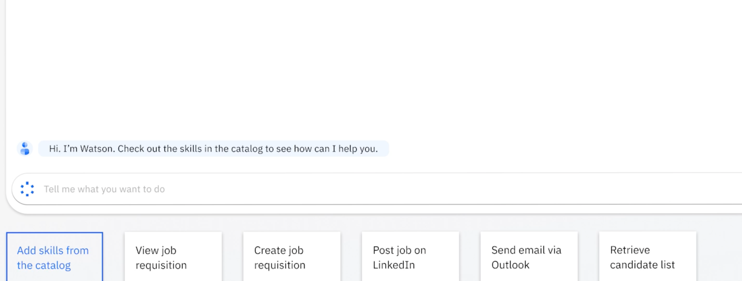
AI assistants in Procurement & sales
Procurement and Sales are dynamic, labor-intensive enterprise function that eat up hundreds of hours per day. From writing job descriptions, onboarding vendors, managing pipelines, automation is here to streamline processes with a solid foundation in AI.
Contractor sourcing Automate the hiring, onboarding and management of new contractors. Leverage AI to identify insight for contract support as well.
Sales pipeline management Reduce burden on sales operations by automating the management of pipeline and surfacing insight to sales leaders.
33

